Slide 1

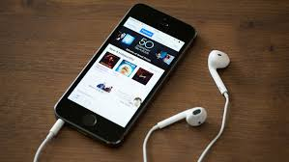


Teaching Personal Finance: Podcasts from Planet Money and Better Money Habits
Doug Young THE WISER CHOICE

Slide 2
Brief Bio
Doug Young is the CEO of THE WISER CHOICE: Economic and Financial Coaching. He is an award-winning teacher, coach, and consultant with more than 35 years of experience in the field of education. For five years Doug served as the Senior Director for the National Center for Economic and Financial Education at The Council for Economic Education in New York City. During that time, he was responsible for creating and conducting workshops for K-12 teachers, not-for-profit educational providers and adult classes. Doug has trained over 7000 K-12 educators nationwide on the teaching of economic and financial literacy. Doug is a dynamic speaker and has presented at the National Council for the Social Studies Conference, National Business Educators Association, as well as state and local conferences in Florida, Utah, Arizona, New York, New Jersey and Connecticut.

Slide 3
Agenda
“Economic Way of Reasoning” and Trans-Disciplinary Learning
Podcasts – Sources and Integration into Economics and Personal Finance Curriculum
Econedlink and “Better Money Habits”
“Planet Money”
More Financial podcasts
More EconEdLink Lessons on Personal Finance
NCSS and Economics (Enduring Issues)
Economic topics on various podcasts
    Tyler Cowan and American Economy
    “On Point” – NPR and WBUR Boston
    Podcasts for debating: Intelligence Squared U.S.
Inquiry Design Model and a “Universal Basic Income”
Questions and Answers

Slide 4
Goals (Learning Objectives)
Teach money management skills through, podcasts, websites and other resources.
Help students find topics about economics and personal finance that relate to them.
Help create a more constructivist, activist classroom for teachers and students.
Use pedagogical lessons, inquiries stressing “hard content” and soft “presentation” skills.
    Critical thinking
    Problem solving
    Communication
    Collaboration
Classes where “Students Are the Workers” and “Teachers Act as Facilitators”.
Add resource to teachers’ “Tool Box” to help make them more effective educators.
Integrate and stress “An Economic Way of Thinking” across the social studies curriculum.

Slide 5
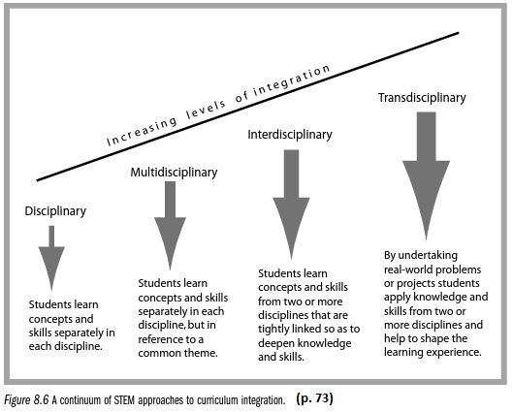
Economics as “Trans-disciplinary Learning”

Slide 6
The Six Principles of Economic Reasoning
We need to integrate these principles into our social studies lessons
People choose.
People's choices involve costs.
People respond to incentives in different ways.
People create economic systems that influence people’s choice and incentives.
People gain when they trade voluntarily.
6. People’s choices have consequences that lie in the future
  Intended - Primary
  Unintended - Secondary

Slide 7
What do kids care about?
Equity
Fairness
Themselves
Connection to their world
Being adults but their way
Fun
Stability
Freedom
Sense of accomplishment
Being respected!!!
Not losing face.
Growth
Security
Others???
These attributes will vary depending upon your students.
Try linking these issues to your historical lessons
Life on a manor, leaving the farm for factory work, job promotion, etc.

Slide 8
Using Podcasts to Teach Economics and
Critical Thinking Skills
What is a podcast?
  It’s an amalgamate of “ipod” and “broadcasting” downloaded to a computer or mobile device.
  Online – a blog in audio form
  Simply: a type of radio show which allows access to information.
Podcasts stimulate learning through creative means for active learning.
Podcasts come in many shapes and sizes (from 5 to 55+ minutes)
Using Podcasts helps integrate “hard” and “soft” skills”.
  Critical thinking
  Problem solving
  Communication
  Collaboration

Slide 9
Benefits of Using Podcast
Ease of Accessibility:
  Constant streaming of new topics, different views, presenters.
  Many podcasts can be downloaded for note-taking.
  Accessible any time they want,
Archive of Lessons
  Many podcasts can be downloaded or saved for later date.
  Teacher can gain easy access to podcast as well.
Updates, if you subscribe:
  Many podcasts get updated and students receive the info automatically.
  They can follow the continuing debate on their issue.
Learning on the go:
  Can be used at home, trip, if absent from school.
  No need for teacher to supply materials. Assignment, rubric, etc. can also be online.
  Great for modification and differentiating for students with special needs.
Creative learning:
  Students get to choose their topics, a learning buy-in.
  Students can create their own podcast on their chosen topic.

Slide 10
Plan, Produce and Reflect
Plan
  Create opportunities for students to assume new roles
  Examine problems in issues
  Pose possible solutions to current issues
Produce
  Make class more interactive.
  Engage reluctant or less eager leaners.
  Adaptability for integrating them into a unit at any time.
  Have students make decisions and accepting trade-offs which is a responsibility that we all have as citizens of the United States.
Reflect
  Create “Socratic Dialogues” after all presentations.
  Execute ideas: Learn from mistakes
  Show how decisions influence our local, state, national and global economies.

Slide 11
Problems
Check your districts policy use.
Anyone can post a blog/podcast. Be aware.
What sites does your school filter as you may want to broaden the choices.
Do all students have access to iphones, etc.
IN PRINT, podcast sites not listed on your handout, must be pre-approved.
Make sure students are aware of any bias, prejudice, links to controversial groups or positions (Holocaust was a fake, etc.)
Continually check the podcasts being used
  Verify the content, producers, etc.
Remind them: Notes and bibliography of all sources must be turned in.

Slide 12
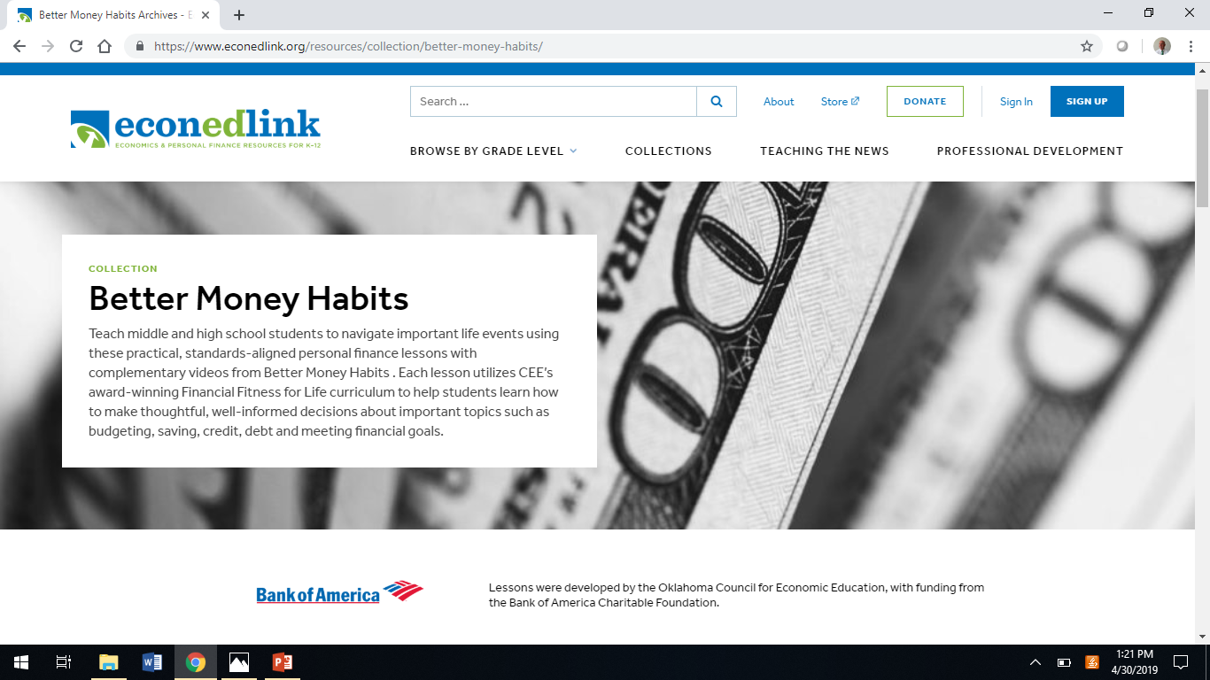

Slide 13
Khan Academy: “Better Money Habits Videos” https://bettermoneyhabits.bankofamerica.com/en
Getting Out of Debt
Renting a Place to Live
A Moving Experience: How Much Does it Cost?
The Basics of Saving and Budgeting
Budgeting Basics
Building Good Credit Scores
Credit Reports and Credit Scores
Buying a Home
Owning a Car
Creating a Financial Safety Net
Meeting Financial Goals
Building a Better Budget
Checking Out Checking Accounts
Setting Goals
Debit Cards vs Credit Cards
Establishing Credit
What Car Should I Buy?
How Does Your Family Save?

Slide 14
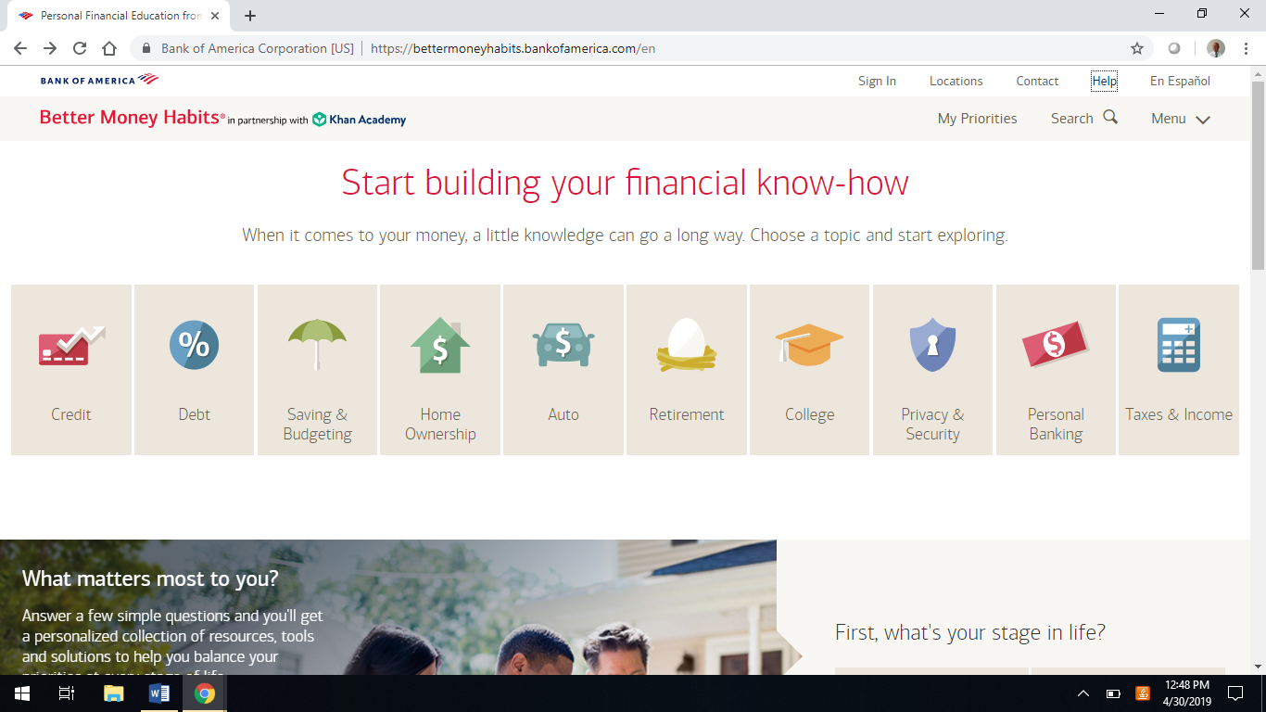

Slide 15
Credit: Materials on Website for Classroom Use
Main Headings
  Choosing a card
  Credit Report
  Credit score
  How Credit Cards Work
  Managing Credit Cards
Videos:
  Building credit and keeping yours healthy.
  How to build credit from scratch?
  How is credit card interest calculated?
  The true cost of paying only the minimum on your card.
Info:
  Five facts about credit cards.
  Dealing with credit card fraud or I.D. theft.
  Rebuilding your credit score.
Info graphs:
  How is a credit score calculated?
Did you know? (Info articles)
  Your credit report: What you need to know
  Do you need multiple credit cards?
  What is a credit card cash advance?
  How to pick the right rewards card.
  Credit card interest.
Definitions
  APR
  Secured and Unsecured cards
  Credit Limits
Pros and Cons on topic issues

Slide 16
Planet Money http://www.npr.org/sections/money/127413729/podcast/
Hail To College Access
  Research shows students who attend elite universities are more likely to graduate.
  They earn higher incomes once they're in the labor market..
  Low-income students are underrepresented at those universities.
When Tariffs Hit Home
  Trade spat with China has meant taxing products coming from the U.S.
  U.S. doing the same to goods coming from China.
  American goods cost more in China, hurting people who make those goods in America.
What The Future Of Work Means For Cities (U.S. Census and its impact)
  Vital information from U.S. households is used to create an updated set of demographics.
  These demographics help the U.S. Government to decide allocation of federal monies.
  Economists use the data to identify trends where employment in the U.S. may be headed.

Slide 17
Taming the High Cost of College https://www.tamingthehighcostofcollege.com/category/podcast/
Understanding College Tax Deductions
Making College Financial Decisions
Getting Additional Support Beyond Your High School
Charting a Path Through College
The Ugly Truth About Debt
What Parents of Juniors Need to Be Doing
How to Be More Successful in College Interviews
Get Out of College Debt Free
How to Find a College Internship to Super Charge your Career

Slide 18
“Jill on Money” with Jill Schlesinger https://www.stitcher.com/podcast/jill-on-money
Rent versus Buy
Considering a Job Offer
When to Sell Real Estate
Should I Do A Roth Conversion
525 Plans and College Savings
Your Money with Ron Lieber
A New Future for Women
Last Minute Tax Tips
Love and Money
Simple, Smarter Students Loans
How to Invest Extra Money
Can I Retire Early
Broke Millennial Takes on Investing
Dumb Things Smart People Do with Their Money
Should You Fire Your Male Broker
Help My Student Loans Are Killing Me

Slide 19
The Dave Ramsey Show https://www.stitcher.com/podcast/the-dave-ramsey-show-38902
Next Steps for College Students Who Are Graduating Debt-Free
Should Chris Buy a $9,300 Bed Interest-Free?
How to Assess the Risk of Putting Money in the S & P 500
Zero-Based Budgeting
Dave’s Advice on Debt
How to Get Out of Debt
Identity Theft Protection
Dave’s Tips on Buying a Used Car

Slide 20
EconedLink
Income Inequality
  https://www.econedlink.org/resources/income-inequality/
Minimum Wage / The Challenge of Living on it
  https://www.econedlink.org/resources/minimum-wage-the-challenge-of-living-on-it/
Immigration
  https://www.econedlink.org/resources/immigration/
Broad Social Goals of an Economy
  https://www.econedlink.org/resources/broad-social-goals-of-an-economy/
Five Stages of Investing
  https://www.econedlink.org/resources/the-five-stages-of-investing/
Preparing Your Form1040
  https://www.econedlink.org/resources/preparing-a-1040ez-income-tax-form/

Slide 21
Integrating Economic and Enduring Global Issues
How old are your textbooks?
How do I access materials current to my lessons and today's world?
Tom Freidman calls this era the “Age of Acceleration” and the 3M’s.
  The Market Place (Globalization)
  Mother Nature ( Climate Change)
  Moore’s Law (the “Speed of Technology” solving and creating problems)
The “Brave New World” of today and the future for our students.
Where do we find materials which deal with these current topics?
Will our students be “Global Citizens” and “Civic, College and Career” ready?
How will they be prepared to face, discuss and deal with domestic and global issues?

Slide 22
N.C.S.S. Enduring Issues
Imperialism
Environment and Society
Science and Technology
Needs and Wants
Nationalism
Cultural and Intellectuals Life
Scarcity
Urbanization
Political Systems
Civic Values
Places and Regions
Institutions
Foreign Policy
Human and Physical Geography
Justice
Belief Systems
Human Rights
Conflict – Armed
Citizenship
Movement of People and Goods
Power
Change – Political Leaders, Revolution
Economic Systems
Interdependence
Reform Movements
Constitutional Principles

Slide 23
Topics Found in Recent Podcasts
Vanishing Summer Jobs for Teens
Fantasy Sports Gambling (Crack Cocaine for Gamblers)
A New Way to Pay for College
Is the News We See and Read, Really “Fake”?
Should we Ban “College Football”?
Healthcare (Obama Care or Trump Care?)
Forever Prison
Divided States of America (Red v. Blue).
Liberals are Stifling Intellectual Diversity on Campuses.
Call a Convention to Amend the Constitution.
Should the U.S. Let in the @1,000,000 DACA People?
Should We Support “Performance Enhancing Drugs”?
Chasing Heroin: Will a “Wall” Stop the Drug Trade?
Growing Up Trans: The Journey, Struggles and Choices.
What is “Putin’s Way” with the World?
Do Videos Games Make Us More Intelligent?
What are the Costs and Benefits of “Fracking’?
Genetically Modified Food and our Body.
Partition of India and Today’s Impact (1947-2019)
Our “Life Spans” and Economic Impact.
What can be Done About Sexual Assault on College Campuses?
Climate Change: REALLY?
Raise the Federal Gas Tax to Fund Infrastructure
Artificial Intelligence: Risks v. Rewards

Slide 24
Tyler Cowan on the American Economy
American Culture and Innovation –
  https://www.mruniversity.com/courses/everyday-economics/the-complacent-class
  The Complacent Class: The Stagnation of the American Economy
  The New Era of Segregation: Socio-economic integration is stagnant.
  American Stasis: How Tech Giants Are Changing Society.
  The Missing Men: Working age men (ages 25-54) are not working. Why?
  The Great Reset: Economic progress is not continual and inevitable.
Women in Economics –
  https://learn.mruniversity.com/women-economics-series/?utm_source=drip&utm_medium=email&utm_campaign=New+series%3A+Women+in+Economics&utm_content=New+series%3A+Women+in+Economics
  Celebrate the lives and work of the trailblazing women of economics.
  First episodes profile Elinor Ostrom, Janet Yellen, Anna Schwartz, and Joan Robinson.
  Special video on: “Who Are Your Inspiring #WomenInEcon?

Slide 25
On Point - WBUR https://www.wbur.org/onpoint
Inside The Farm Bill: Subsidies For Farmers, Boost For Hemp And More
  https://www.wbur.org/onpoint/2018/12/18/farm-bill-trump-hemp-subsidies-farmers-congress
Unemployment Down, Wages Stagnant, Retirement Difficult: An Economic Survey
  https://www.wbur.org/onpoint/2018/12/17/economy-unemployment-wages-retirement
Stock Market Distress Signal: How Low-Cost Index Funds Are Taking Over
  https://www.wbur.org/onpoint/2018/12/12/stock-market-index-funds-john-bogle
We Are No Longer the Customers: Inside: “The Age Of Surveillance Capitalism”
  https://www.wbur.org/onpoint/2019/01/15/surveillance-capitalism-online-data-privacy-facebook-google-amazon
Are Millennials Really So On The Move?
  https://www.wbur.org/onpoint/2018/08/06/millennial-jobs-homes-myths
Can Gentrification Be A Good Thing?
  https://www.wbur.org/onpoint/2018/08/06/millennial-jobs-homes-myths

Slide 26
Intelligence Squared US https://www.intelligencesquaredus.org/
Listeners have access to the brightest minds in journalism today.
Topics: Domestic and foreign policy, cultural trends and technological innovations.
Debate presentations are downloadable.
There are four debaters which two sides debating each other.
Ability to listen to the debate and download the actual debate.
Access to further research and related posts on the topic.
Ability to the join upcoming conversations online and respond.

Slide 27
Other Topics of Interest to Students
Policing is Racially Biased.
Is Social Media Good For Democracy?
Unresolved: The Techonomic Cold War With China.
Silicon Valley has Lost It’s Soul.
Unresolved: U.S. National Security.
Automation Will Crash Democracy.
Bitcoin Is More Than a Bubble and Here to Sta.
Humanitarian Intervention Does More Harm Than Good.
Pay College Athletes.
Artificial Intelligence: The Risks Could Outweigh the Rewards.

Slide 28
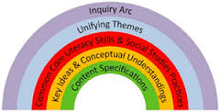
The “Arc of Inquiry”:
A Framework for Teaching and Learning
The National Council for the Social Studies Inquiry Design Model
www.c3teachers.org
https://www.engageny.org/resource/new-york-state-k-12-social-studies-resource-toolkit

Slide 30
Inquiry Design Model (IDM) Blueprint
Compelling Question
Key Ideas and Practices
Staging the Question
Supporting Question 1 | Supporting Question 2 | Supporting Question 3
Formative Performance Task | Formative Performance Task | Formative Performance Task
Featured Sources | Featured Sources | Featured Sources
Summative Performance Task | Argument
 | Extension
Taking Informed Action

Slide 31
Inquiry Design Model (IDM) Blueprint
Compelling Question | Can a “Universal Basic Income” help decrease poverty in our country?
Key Ideas and Practices | Practices (Thinking Skills): Gathering, Interpreting and Using Evidence, Chronological Reasoning and Causation, Comparison & Contextualization, Economics and Economic Systems Key Ideas (Lens): Time, Continuity and Change; Interaction of Economic Systems,
Staging the Question | What did Martin Luther King, Jr. have in common with Richard Nixon and with 18th century revolutionary Thomas Paine, author of Common Sense? Well, all three thought it was common sense to guarantee to every citizen who breathes a set amount of cash every year, essentially as a right, and firstly, to protect against poverty. Nowadays, that idea is flying high again. Could such a program lift many Americans out of poverty?
l

Slide 32
Supporting Question 1 | Supporting Question 2 | Supporting Question 3
What system do we have now and why is it failing? | What is a “Universal Basic Income” and its pros and cons? | Where has this system been used and what is the success of such a system?
Formative Performance Task | Formative Performance Task | Formative Performance Task
Poster Board of all existing policies (SNAP, EITC, Child Tax Credit, Medicare, Medicaid, Social Security, etc.) | Present an Oxford Style Debate with two groups of students presenting the two sides based on sound research. | List the five countries where this system has been introduced and results of the experiment to date.
Featured Sources | Featured Sources | Featured Sources
https://www.theguardian.com/money/us-money-blog/2014/nov/12/social-welfare-programs-food-stamps-reduce-poverty-america The Guardian: Welfare programs shown to reduce poverty in U.S. | http://www.intelligencesquaredus.org/debates/ universal-basic-income-safety-net-future America’s Debate System: Bringing civility and respect back to our most important national conversations. | https://www.worldcrunch.com/culture-society/universal-basic-income-5-experiments-from-around-the-world-1 UBI - Five experiments around the world.

Slide 33
Summative Performance Task | Argument | Construct an argument (e.g., detailed outline, poster, or essay) that addresses the compelling question using specific claims and relevant evidence and information from contemporary sources.
 | Extension | Create a guide to the “UBI” that explains why Americans might consider this act. Within the guide, include a list of credible resources for learning more about the Universal Basic Income.
Taking Informed Action | Voting, Letter to Congressperson, petition for a cause, volunteer for a campaign, run for public office when eligible, other ways one could get involved about an issue which they feel strongly about.

Slide 34


Are there any questions?

Slide 35
Thank you!
Doug Young
The Wiser Choice
CEO/Head Coach
    doug.n.young@gmail.com
    914-715-9969

